Slide 1


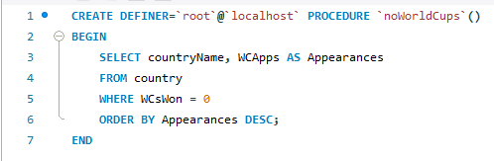
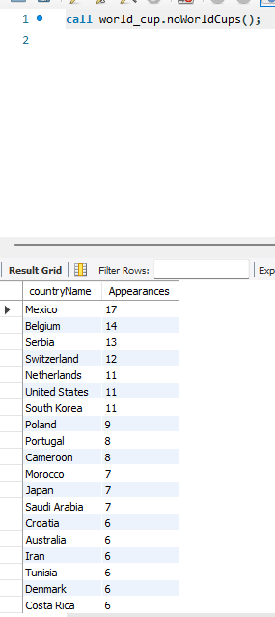
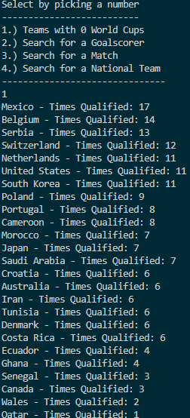
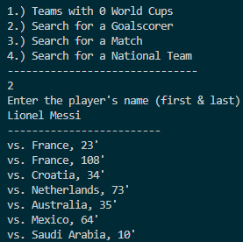
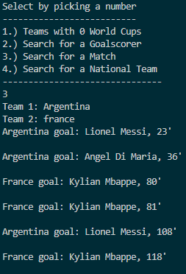
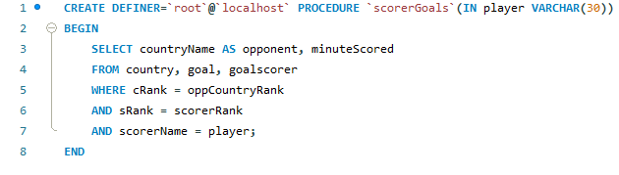
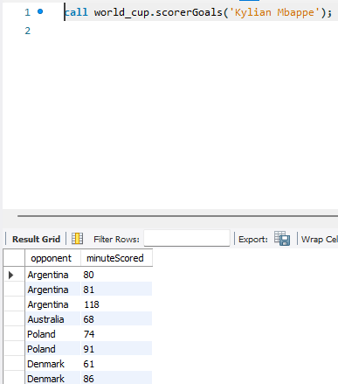
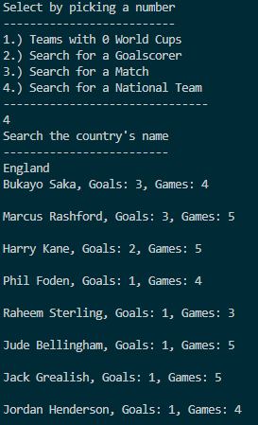
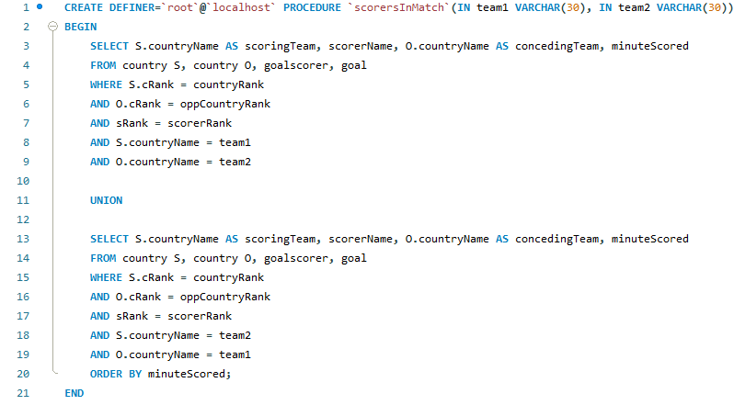
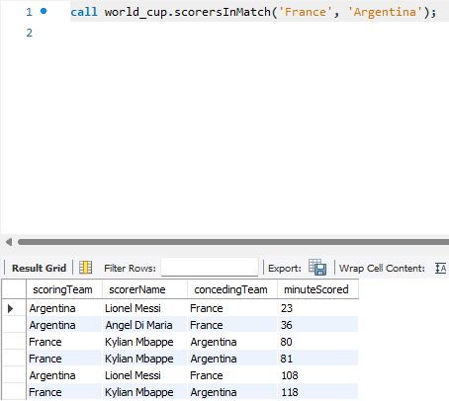
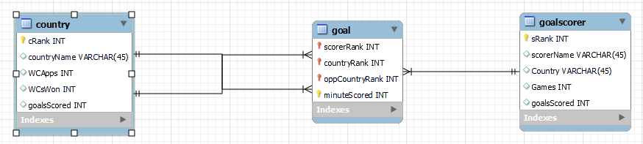
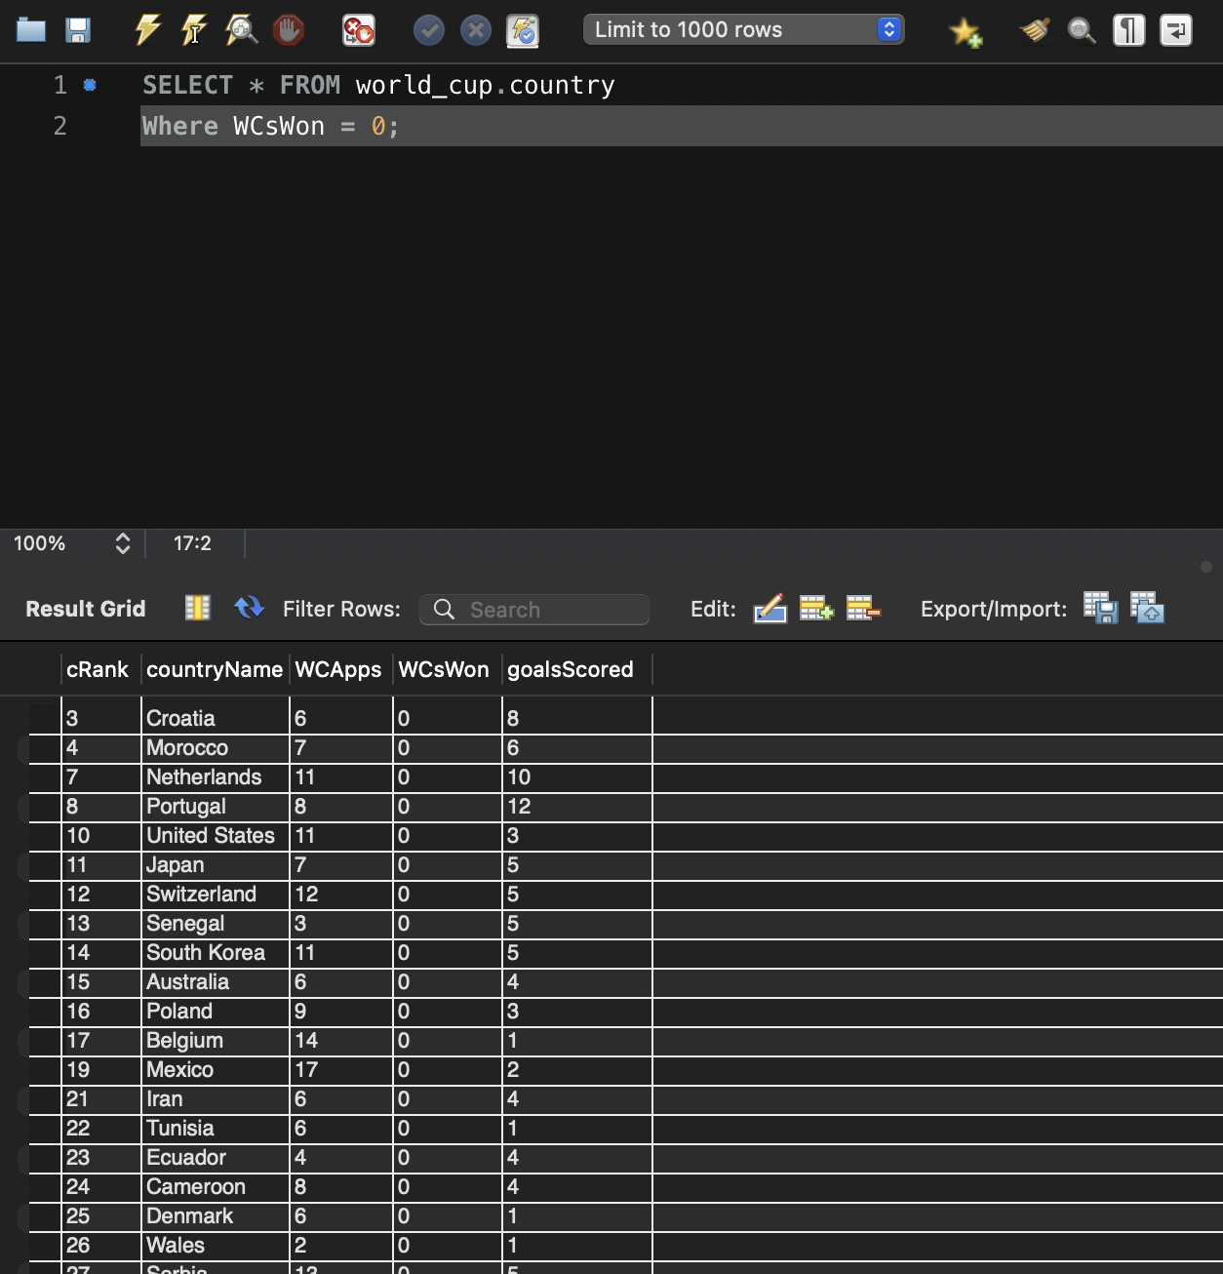

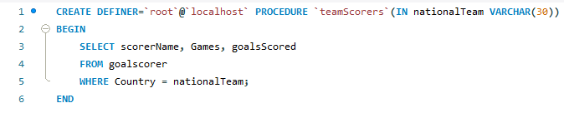
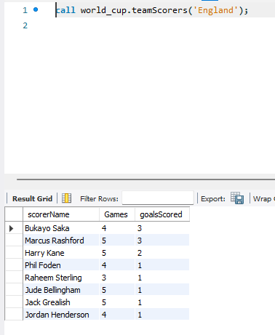
2022 FIFA World Cup with Relational Databases
William Cordor
Faculty Advisor: Nada Alsallami, Ph.D
Department of Computer Science at Worcester State University
Introduction
Stored Procedures
Outputs
FIFA World Cup is the largest sporting event in the world
Difficult to access more specific information about a specific goal scored
For example:
Who scored the goal?
Who was the goal scored against?
How many goals has that player scored?
What was the time in the game that the goal was scored?
Relational Database will provide easy access to distinct, interesting data relating to players and countries who participated in the 2022 FIFA World Cup
noWorldCups() - displays information on nations that have never won the World Cup
scorerGoals() - lists out all World Cup goals from a specific player and information about each of them
Tools
MySQL Relational Database
scorersInMatch() - displays information on all the goals scored in a match between two specific countries
MySQL Relational Database
Java
Java SQL Connector
Visual Studio Code
Three entities: “country”, “goal”, “goalscorer”
Future Works
Entities were populated with real-life data that took place in the 2022 World Cup
32 nations qualified
117 different players scored at least 1 goal
172 total goals were scored
Broaden database to feature data from all World Cup editions
Add more statistics than goals, games and World Cup victories
Improve user interface by increasing content to choose from
Many different queries were ran, producing various instances of interesting data
Queries that produced most interesting data were saved and formed into stored procedures
References
countries must actually have played each other in World Cup
Example is of 2022 World Cup Final
2022 World Cup - list of goalscorers 2022. Transfermarkt. (n.d.). https://www.transfermarkt.com/weltmeisterschaft-2022/torschuetzenliste/pokalwettbewerb/WM22/saison_id/2021
FOX Sports. (n.d.). FIFA Men’s World Cup history - past World Cup winners, hosts, most goals and more. FIFA Men’s World Cup History - Past World Cup Winners, Hosts, Most Goals and more | FOX Sports. https://www.foxsports.com/soccer/2022-fifa-world-cup/history
Pankaj. (2022, August 3). Callablestatement in Java example. DigitalOcean. https://www.digitalocean.com/community/tutorials/callablestatement-in-java-example
The switch statement. The switch Statement (The JavaTM Tutorials > Learning the Java Language > Language Basics). (n.d.). https://docs.oracle.com/javase/tutorial/java/nutsandbolts/switch.html
teamScorers() - displays information for every player that scored a goal in the World Cup from a specific country
Example of SQL query, showcasing countries who have never won a World Cup

